Slide 1


JoSDC’24 Training
Dr. Ruba Alkhasawneh

Slide 2
Simple Processor Design

Slide 3
What is a Processor?
a processor (or central processing unit, CPU) is the primary component of a computer system that performs most of the processing tasks.
It executes instructions from programs, performs calculations, and manages data flow within the computer

Slide 4
Processor Architecture
Instruction Set Architecture (ISA): Defines the set of instructions that the processor can execute, as well as the way these instructions are encoded. Examples include x86, ARM, and MIPS.
Microarchitecture: Refers to the internal design and organization of a processor, including how it implements the ISA. Different processors can have the same ISA but different microarchitectures.

Slide 5
Key Functions of a Processor
Instruction Execution:
Fetch: The processor retrieves instructions from memory.
Decode: The processor interprets the fetched instructions to understand what actions are required.
Execute: The processor performs the actions specified by the instructions, such as arithmetic operations or data manipulations.
Write-back: The processor writes the results of operations back to memory or registers.

Slide 6
Key Functions
Data Processing:
The processor performs calculations and data manipulation based on the instructions it executes. This includes operations such as addition, subtraction, multiplication, and logical operations.
Control:
The processor manages the execution of instructions, including branching (conditional execution) and looping. It also controls data flow between different components of the computer system.
Communication:
The processor communicates with other components of the computer, such as memory, input/output devices, and storage, to exchange data and instructions.

Slide 7
Major Components
Arithmetic Logic Unit (ALU):
Performs arithmetic and logical operations such as addition, subtraction, AND, OR, etc.
Control Unit (CU):
Directs the operation of the processor. It fetches instructions from memory, decodes them, and sends signals to the ALU and other components to execute instructions.
Registers:
Small, fast storage locations within the processor used to hold data, instructions, and addresses temporarily during processing. Common registers include the accumulator, program counter, and instruction register.
Cache Memory:
A small, high-speed memory located close to the processor to store frequently accessed data and instructions, improving overall processing speed.
Buses:
Data pathways that connect the processor to other components of the computer, such as memory and peripherals. Buses can be used for data, address, and control signals.

Slide 8
Processor’s Design

Slide 9
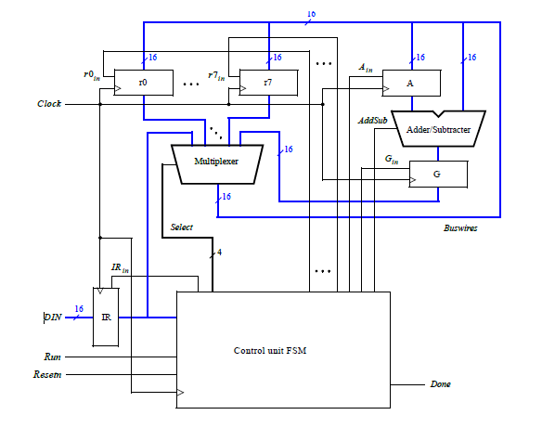
Simple Processor’s Design
16-bit registers
general purpose registers r0, . . . , r7.
multiplexer
Data can be transferred through the 16-bit wide multiplexer from one register in the system to another
adder/subtracter
control unit (finite state machine)
The FSM controls the Select lines of the multiplexer, which allows any of its inputs to be transferred to any register that is connected to the bus wires.

Slide 13
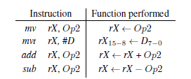
Supported Instructions
The operand Op2 can be either a register, rY, or immediate data, #D.

Slide 14
Instruction Encoding
Instructions are loaded from the external input DIN, and stored into the IR register, using the connection indicated
Each instruction is encoded using a 16-bit format. If Op2 specifies a register, then the instruction encoding is III0XXX000000YYY,
where III specifies the instruction, XXX gives the rX register, and YYY gives the rY register.
If Op2 specifies immediate data #D, then the encoding is III1XXXDDDDDDDDD,
where the field DDDDDDDDD represents a nine-bit signed (2’s complement) value.
Assume that III = 000 for the mv instruction, 001 for mvt, 010 for add, and 011 for sub.

Slide 15
Move Instructions
The mv instruction (move)
copies the contents of one register into another, using the syntax mv rX,rY.
It can also be used to initialize a register with immediate data, as in mv rX,#D.
The mvt instruction (move top)
is used to initialize the most-significant byte of a register.
The instruction mvt rX,#D loads the 16-bit value D7−000000000 into rX.
As an example, to load register r0 with the value 0xFF00, you would use the instruction mvt r0,#0xFF.

Slide 16
Add/Sub Instructions
The instruction add rX,rY produces the sum rX + rY and loads the result into rX.
The instruction add rX,#D produces the sum rX + D, where D is sign-extended to 16 bits, and saves the result in rX.
The sub instruction generates either rX − rY, or rX − #D and loads the result into rX.

Slide 17
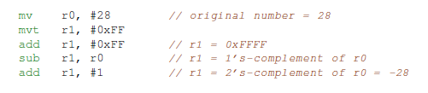
Example
the sequence below loads the number 28 into register r0 and then calculates, in register r1, the 2’s complement value −28.

Slide 18
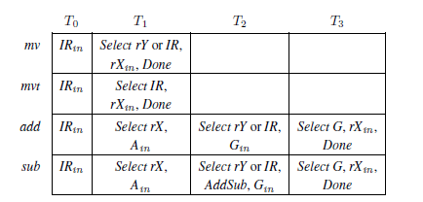
The sequence of instructions produces the same result as the single instruction mv r1,#-28.

Slide 22
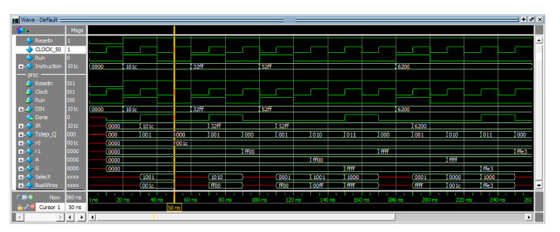
Waveform

Slide 23
Demo-ModelSim

